Slide 1

Economic Analysis Project
Ella Batdelger
ENTER

Slide 2


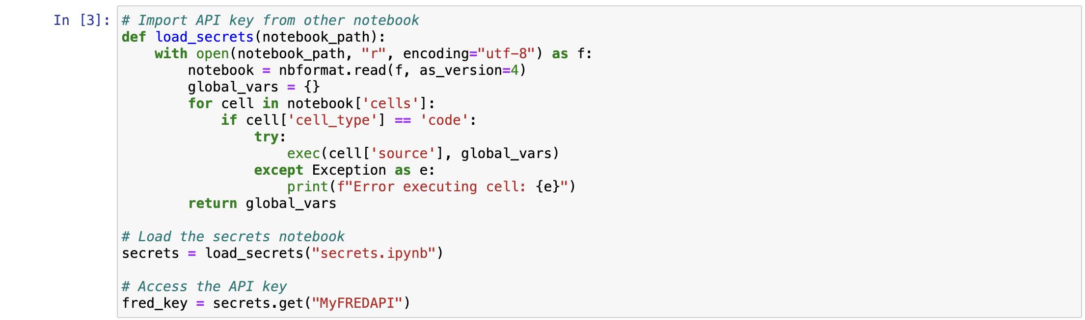

ECONOMIC DATA ANALYSIS using Python
FRED: Federal Reserve Economic Data
Publicly available online database
Data Scraping using API key
01
02
03
04

Slide 3

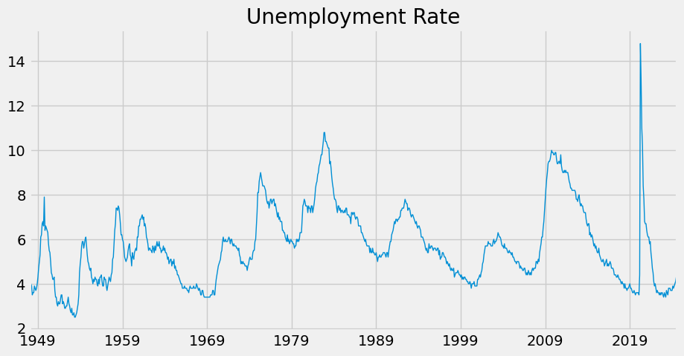
Data Search and Basic Plotting
01
02
03
04

Slide 4
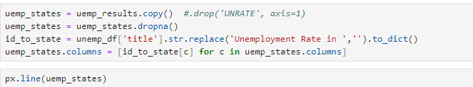
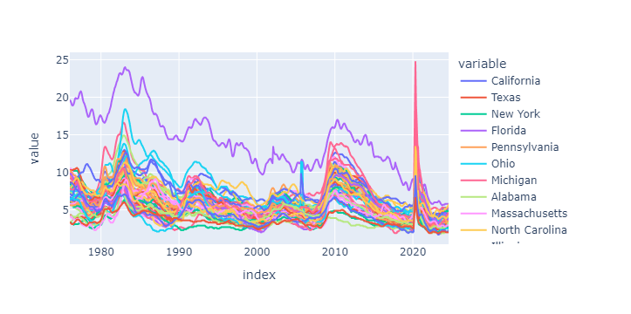
Unemployment % by States
01
02
03
04

Slide 5
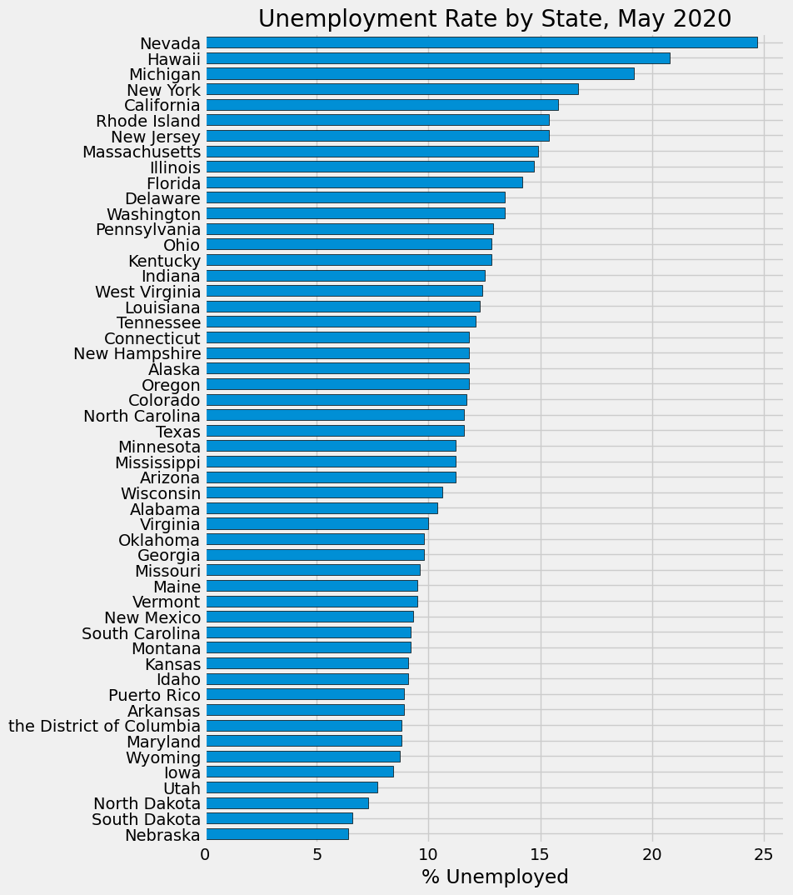
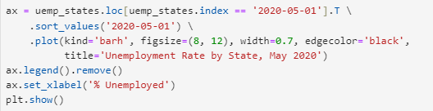
Unemployment rate in May 2020
01
02
03
04

Slide 6
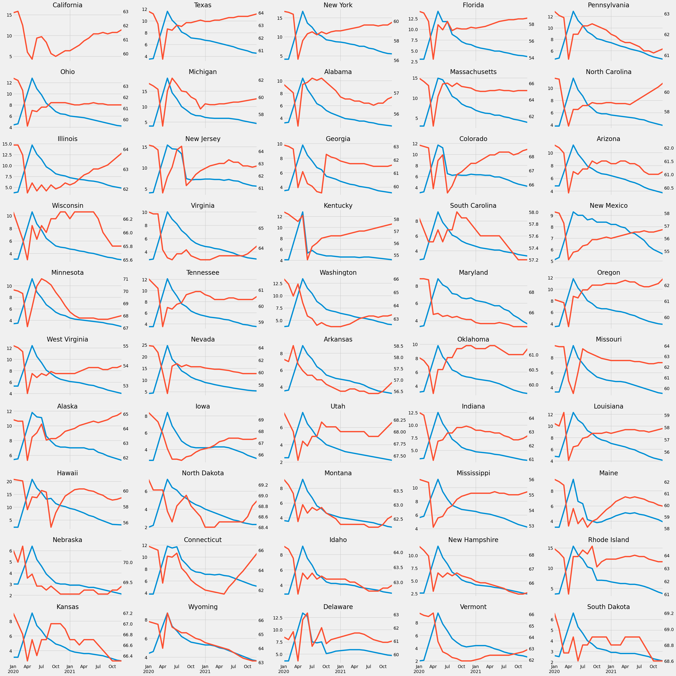
Unem % and LFPR by States
01
02
03
04

Slide 7
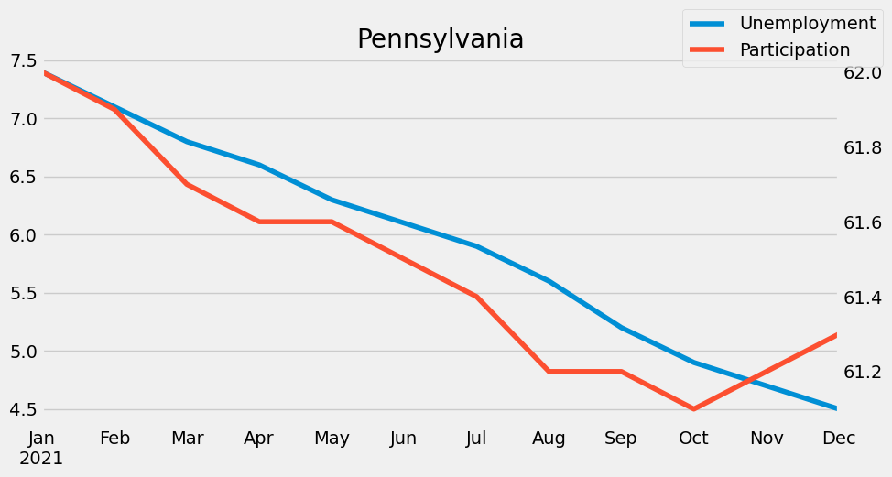
Unemployment% vs LFPR in PA
01
02
03
04

Slide 8
Implications for Stakeholders
01
Policymakers could use this data to identify regions that require more job-creation programs to decrease unemployment rate.
Economists and business owners can also use this data to forecast economic-growth.
Job seekers could also benefit from understanding unemployment trends, allowing them to make more informed decision
02
03
04

Slide 9
Potential Societal Implications
01
Unemployment rate often affects Economic Inequality, Social Well-being, and Public Policy.
This project can help informing policy decisions and raising awareness using data-driven approaches.
02
03
04

Slide 10
Thank you!
01
02
03
04
Questions?

